Slide 1
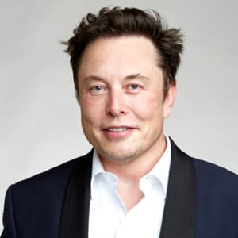
learned programming
founded Zip2
ELON
HOW
MUSK
founded PayPal
Started
founded SpaceX
founded Tesla

